Slide 1
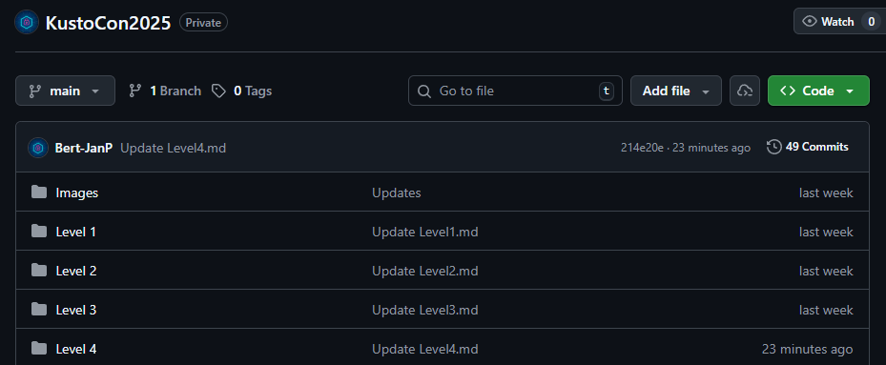
Kickstart
Lab link: https://github.com/Bert-JanP/KustoCon2025
Only level 1-4
Wifi MSFTGUEST Pass: msft1488
Student01@acompanylikeyours.com
Student99@acompanylikeyours.com
%SNIP%
Right (Bert-Jan) side row 1 == 10 2 = 20 3=30
Left (Gianni )side row 1 == 40 2 = 50 3 == 60
⚠️Real malware is used in level 1 & 2!

Slide 2

Welcome

Slide 3
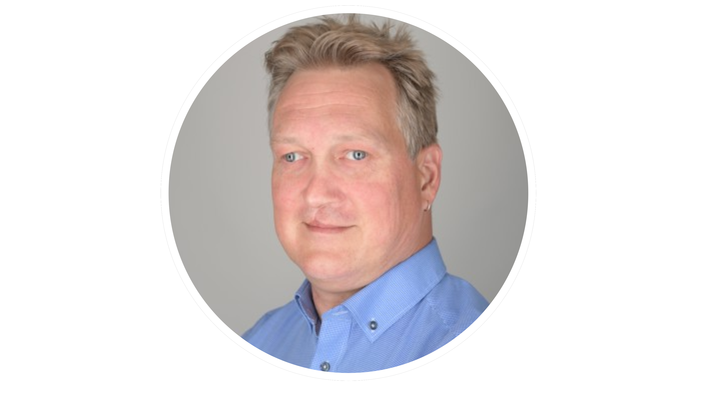
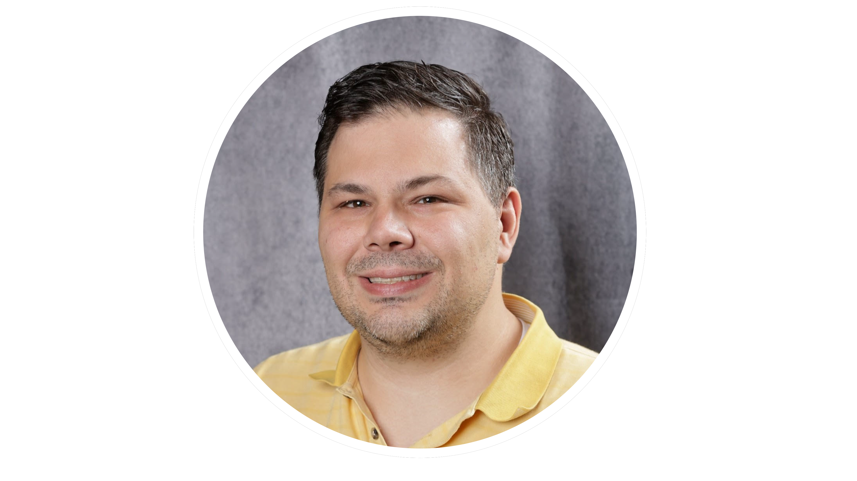
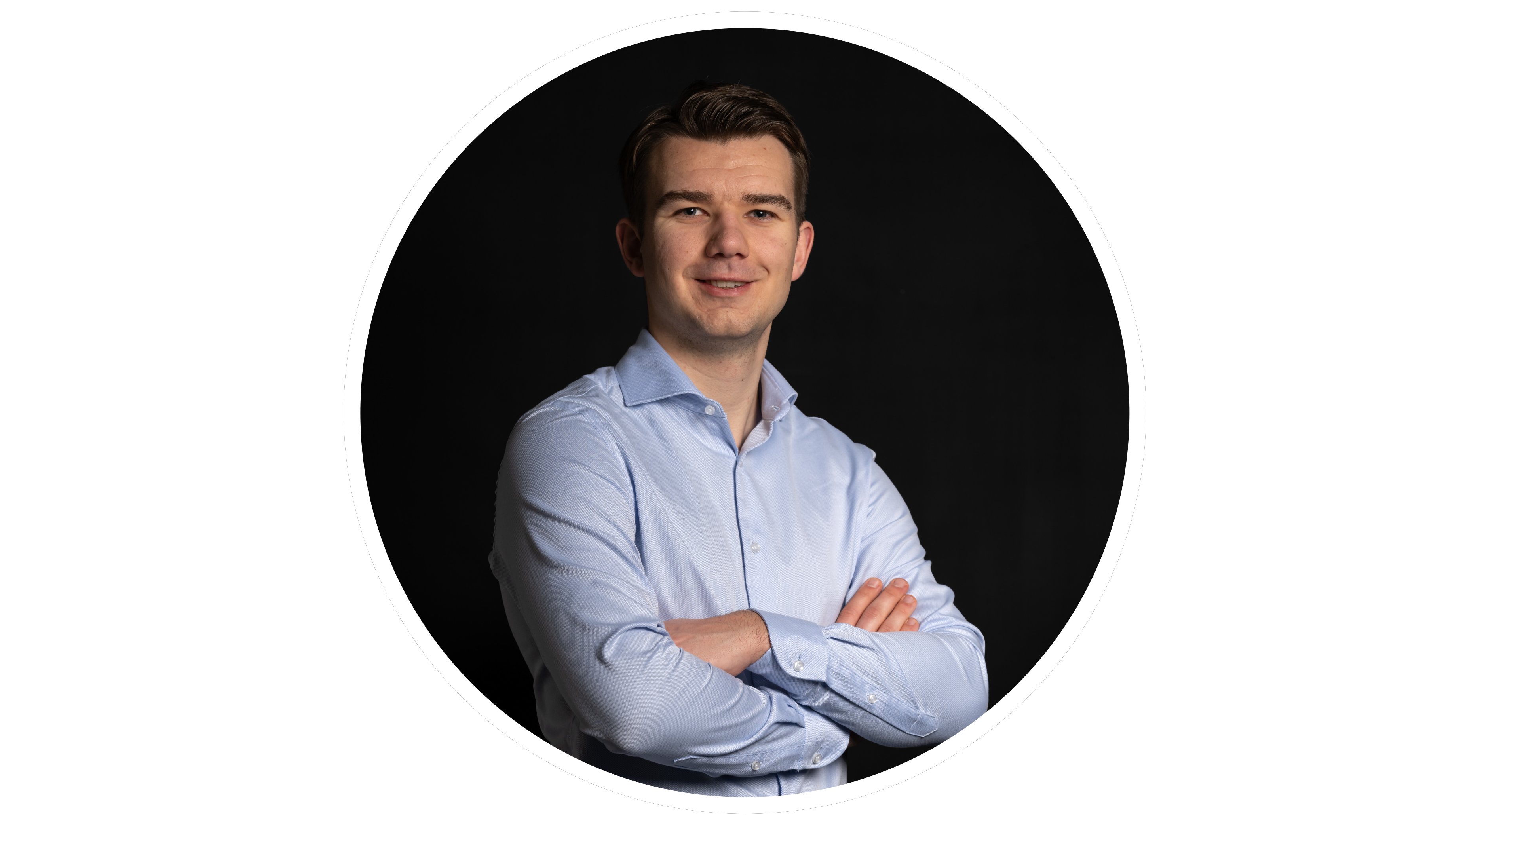
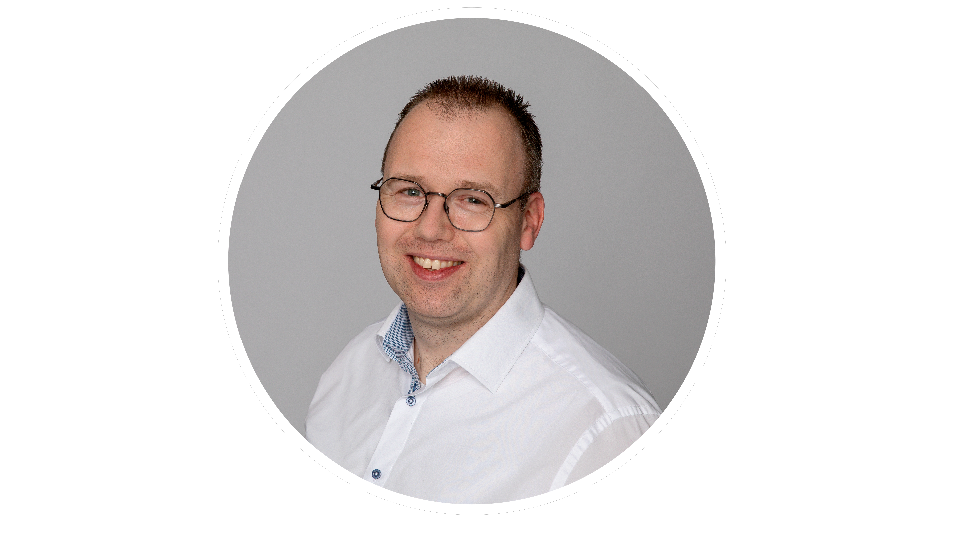
Alex Verboon
Gianni Castaldi
Bert-Jan Pals
Frans Oudendorp

Slide 4
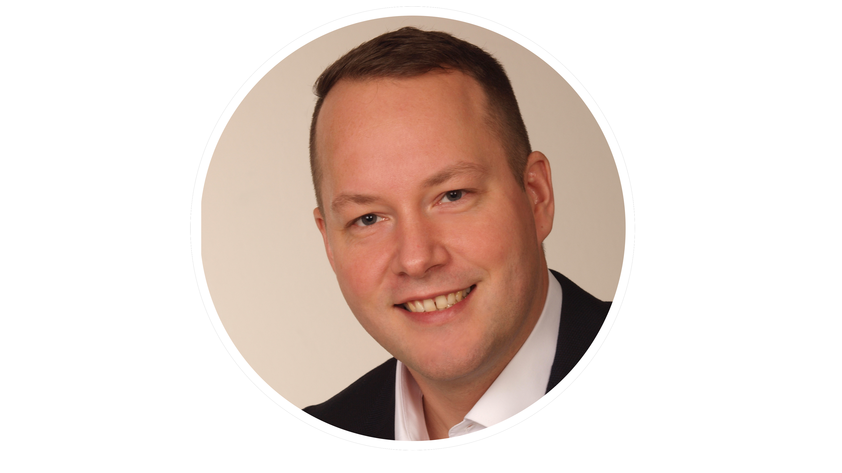

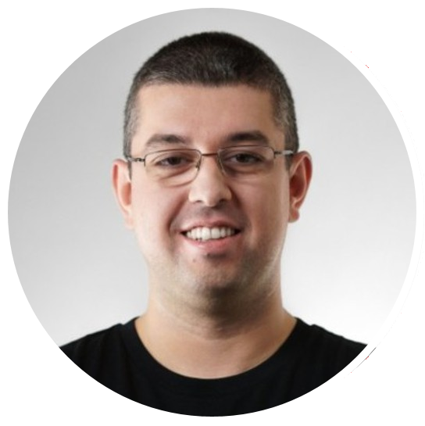
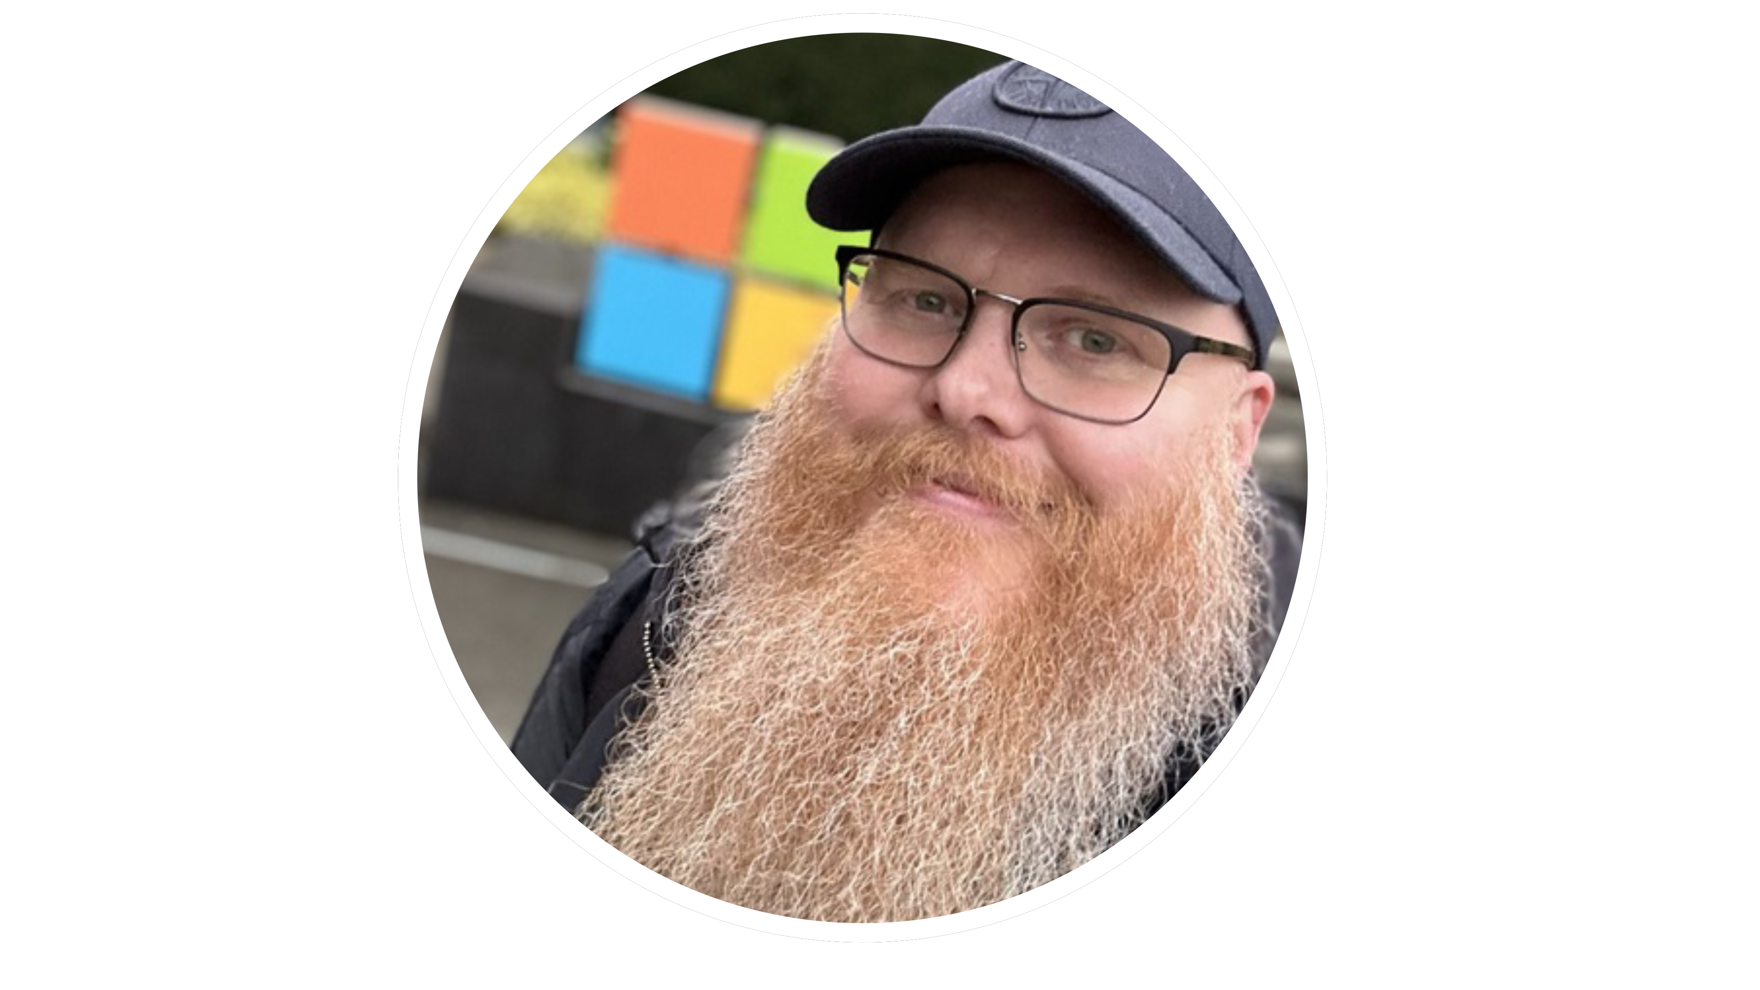
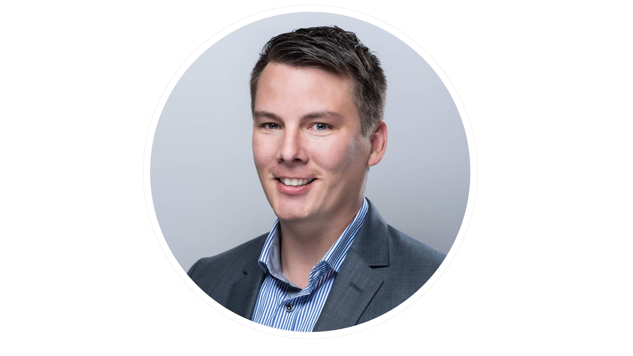
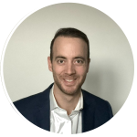
Henning Rauch
Olaf Hartong
Ugur Koc
Mattias Borg
Stefan Schörling
Thomas Verheyden

Slide 5








Thanks to our Sponsors

Slide 6
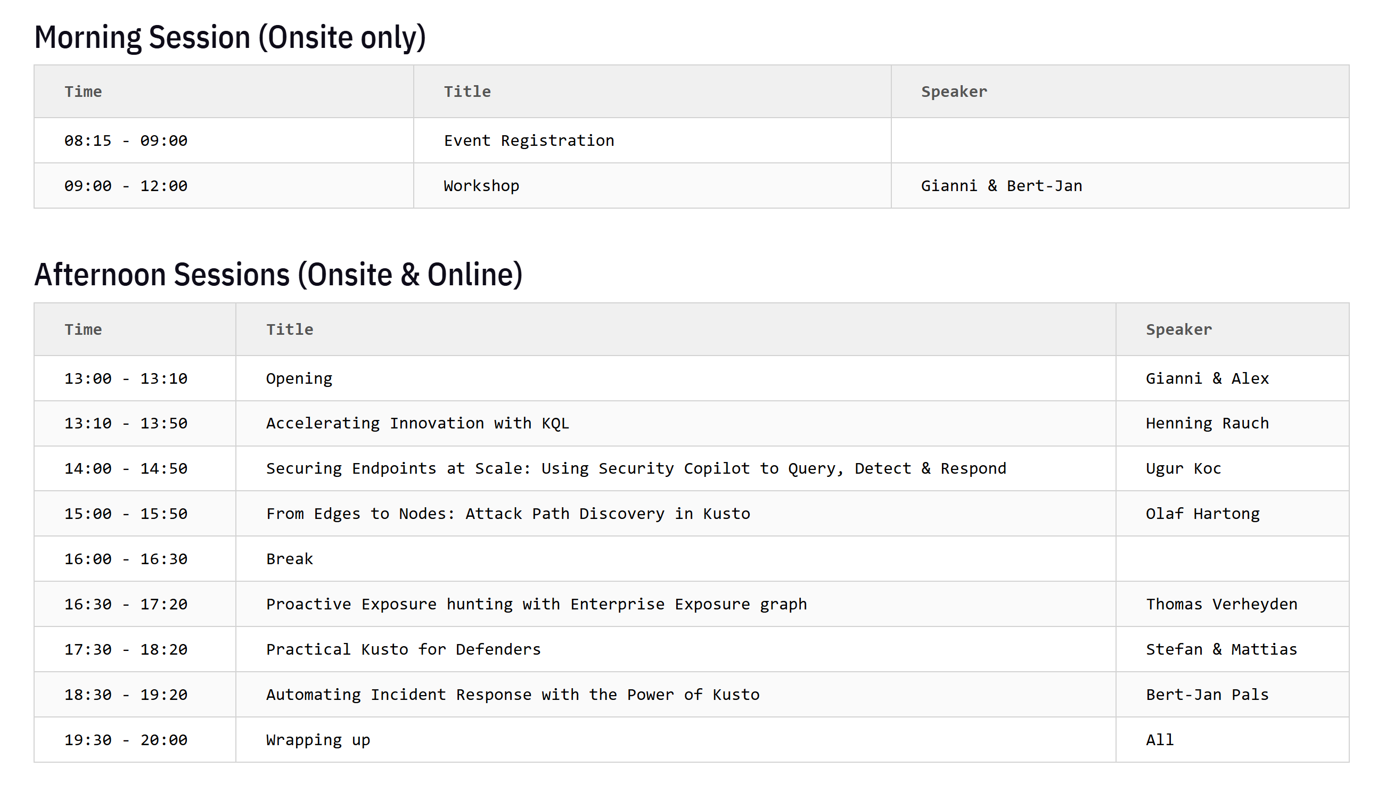

Slide 7
Food & Drinks, Lunch
Coffee, Soft Drinks, croissants, fruits, coockies during breaks
Lunch – self organized

Slide 8
Afternoon Sessions
To provide an optimal online experience we kindly ask everyone to be in the room when sessions start. (No in and out)
Tables will be removed so you can focus on the Session ☺

Slide 9
Kusto Workshop
Bert-Jan & Gianni

Slide 10
Thanks to our Sponsors

Slide 11
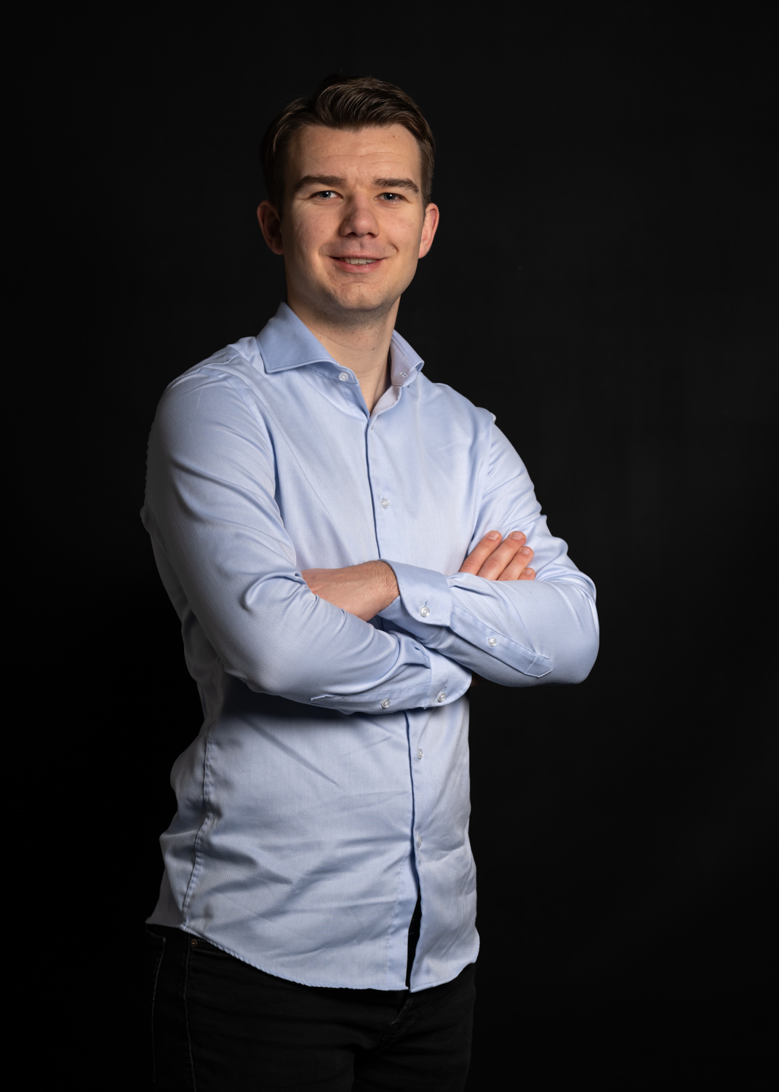





Bert-Jan Pals
https://x.com/BertJanCyber
https://www.linkedin.com/in/bert-janpals/
https://github.com/bert-janp
Defensive Security Expert
https://kqlquery.com/

Slide 12
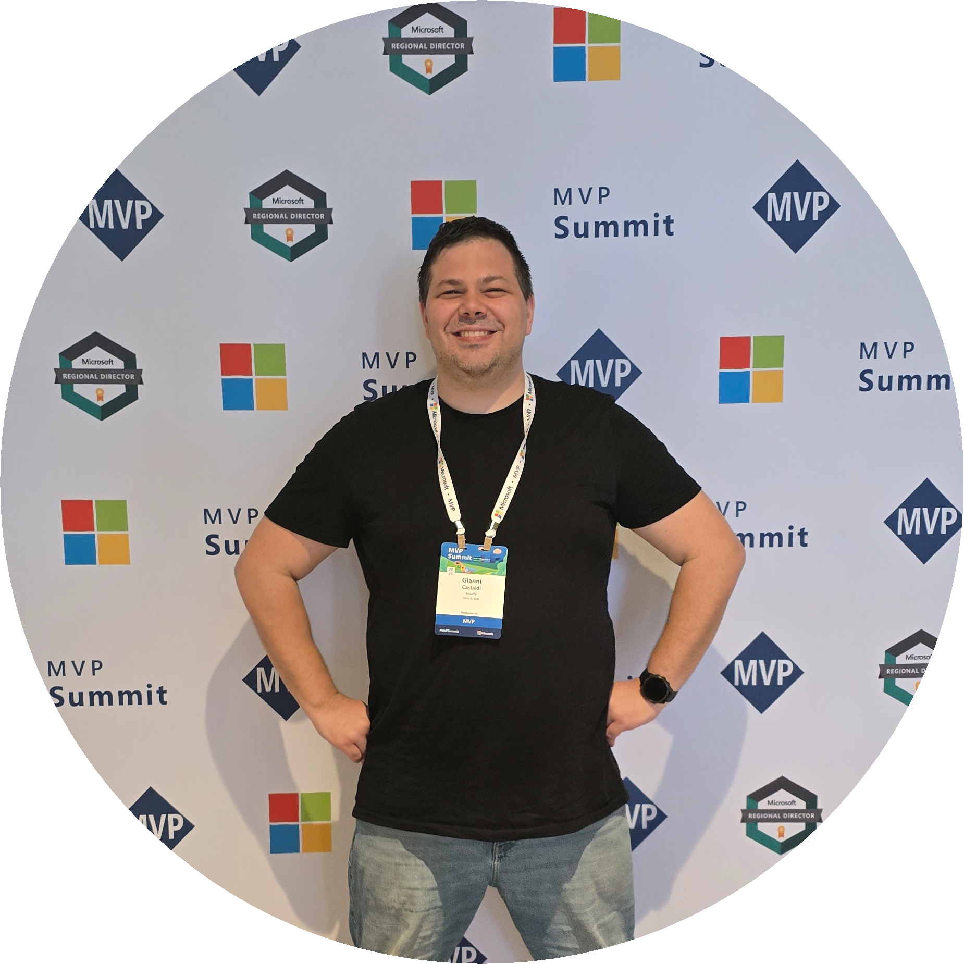
Gianni Castaldi
https://x.com/castello_johnny
https://www.linkedin.com/in/giannicastaldi/
https://github.com/kustoking
Security Consultant
https://kustoking.com/

Slide 13
Agenda
Where do we Start
Small Refresher
Attack Challenges
Full Attack Path

Slide 14
Where do we start

Slide 15
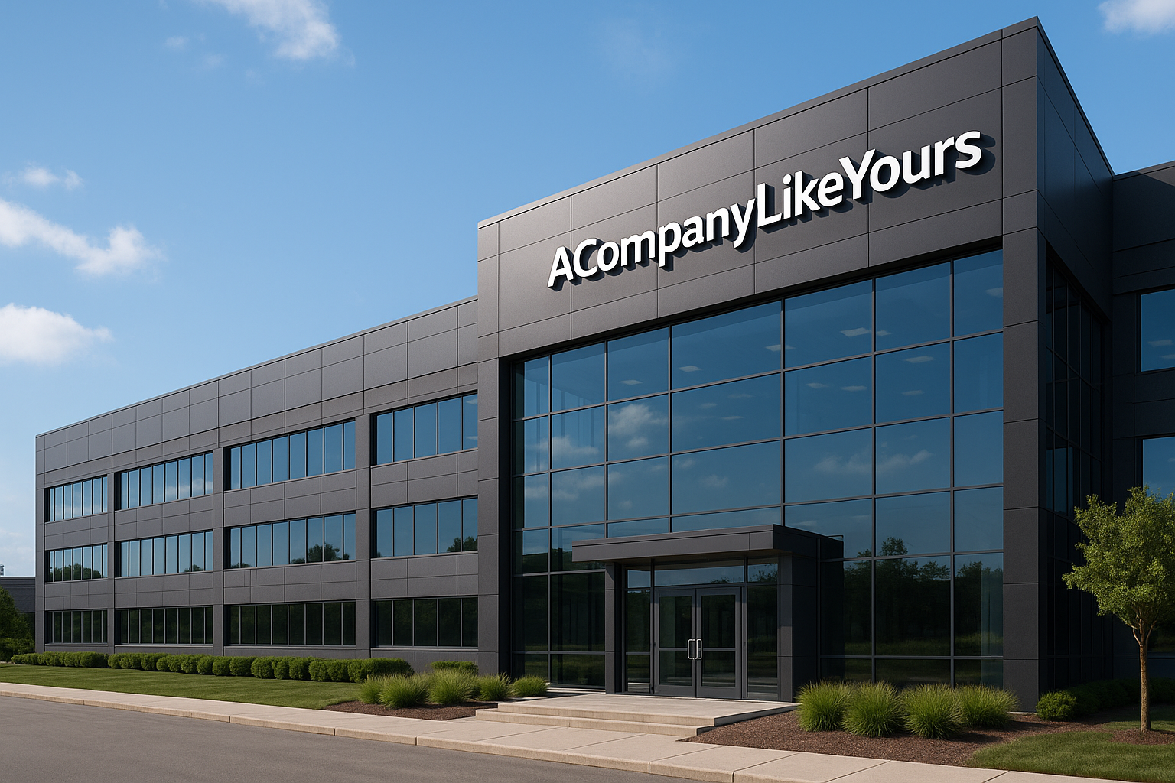
ACompanyLikeYours

Slide 16
Accounts
Student01@acompanylikeyours.com
Student99@acompanylikeyours.com
%SNIP%

Slide 17
Defender Tenant
https://security.microsoft.com/homepage?tid=a4be6261-d211-4df1-852e-c597a96ad887

Slide 18
Small refresher

Slide 19
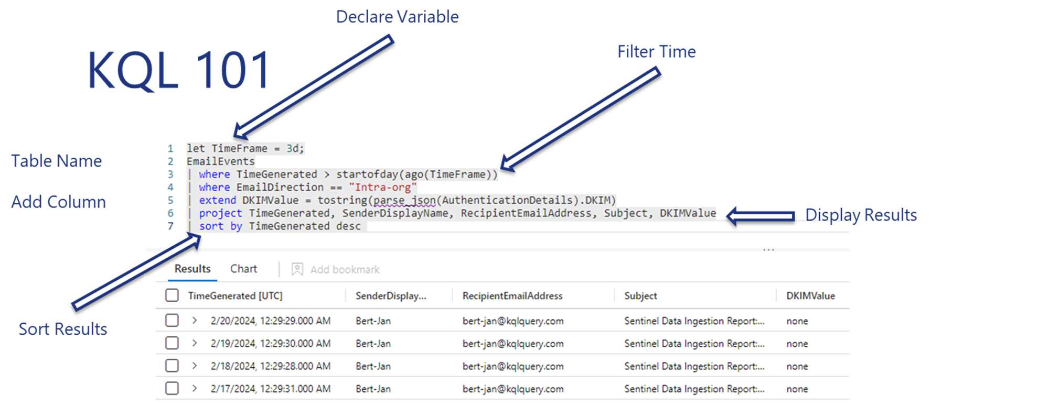
What is KQL again

Slide 20
Interesting features
has has_any
let
FileProfile()
binary_shift_lef()
Scan

Slide 21
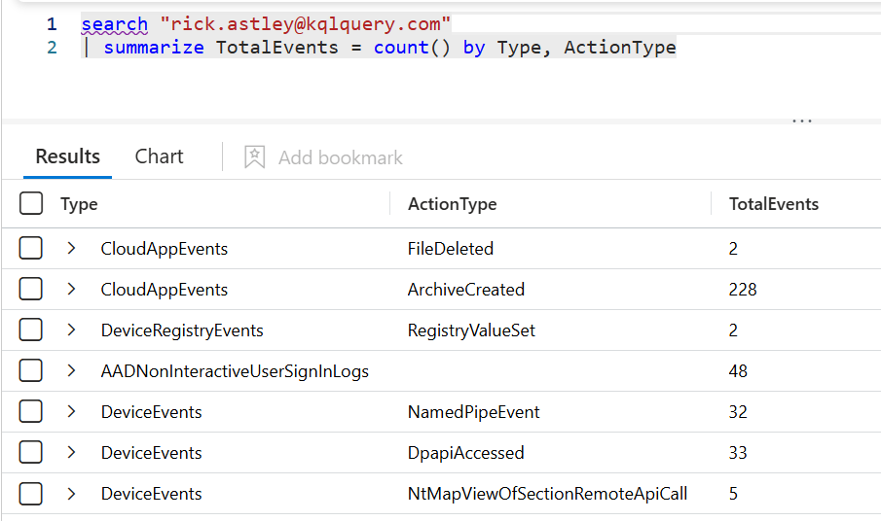
Search entities

Slide 22
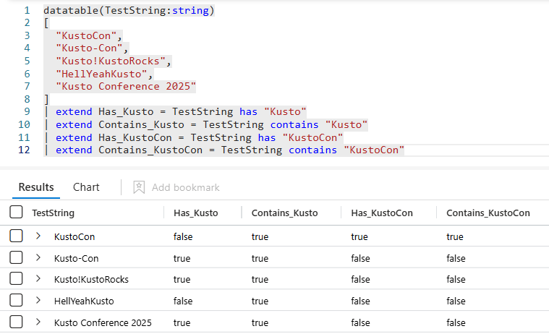
Has vs Contains
Notes:
datatable(TestString:string)
[
"KustoCon",
"Kusto-Con",
"Kusto!KustoRocks",
"HellYeahKusto",
"Kusto Conference 2025"
]
| extend Has_Kusto = TestString has "Kusto"
| extend Contains_Kusto = TestString contains "Kusto"
| extend Has_KustoCon = TestString has "KustoCon"
| extend Contains_KustoCon = TestString contains "KustoCon"

Slide 23
Has_* vs In
has_any works the same as has but for a list
has_all has all values in the list
in equals based on a list
in~ equals based on a list case insensitive

Slide 24
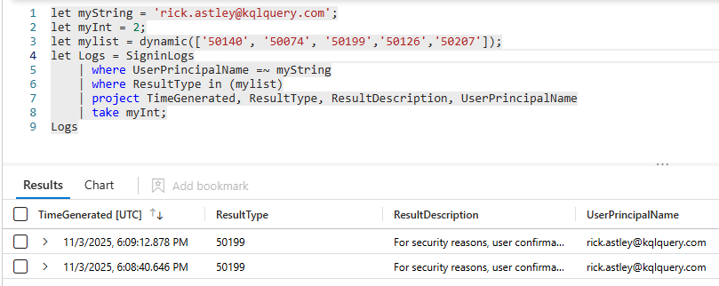
let
Notes:
let myString = 'rick.astley@kqlquery.com';
let myInt = 2;
let mylist = dynamic(['50140', '50074', '50199','50126','50207']);
let Logs = SigninLogs
| where UserPrincipalName =~ myString
| where ResultType in (mylist)
| project TimeGenerated, ResultType, ResultDescription, UserPrincipalName
| take myInt;
Logs

Slide 25
FileProfile()
Enrichement function for files
| invoke FileProfile(Hash_Column,limit)
Limit by default 100, max 1000 unique hashes
Hash Column:
SHA1
SHA256
InitiatingProcessSHA1
InitiatingProcessSHA256

Slide 26
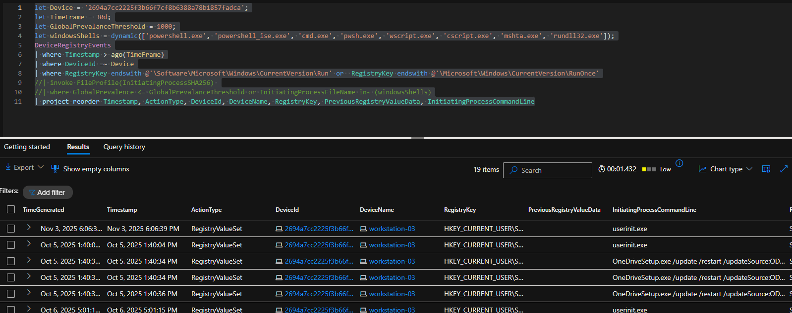
FileProfile()
Notes:
let Device = '2694a7cc2225f3b66f7cf8b6388a78b1857fadca';
let TimeFrame = 30d;
let GlobalPrevalanceThreshold = 1000;
let windowsShells = dynamic(['powershell.exe', 'powershell_ise.exe', 'cmd.exe', 'pwsh.exe', 'wscript.exe', 'cscript.exe', 'mshta.exe', 'rundll32.exe']);
DeviceRegistryEvents
| where Timestamp > ago(TimeFrame)
| where DeviceId =~ Device
| where RegistryKey endswith @'\Software\Microsoft\Windows\CurrentVersion\Run' or RegistryKey endswith @'\Microsoft\Windows\CurrentVersion\RunOnce'
//| invoke FileProfile(InitiatingProcessSHA256)
//| where GlobalPrevalence <= GlobalPrevalanceThreshold or InitiatingProcessFileName in~ (windowsShells)
| project-reorder Timestamp, ActionType, DeviceId, DeviceName, RegistryKey, PreviousRegistryValueData, InitiatingProcessCommandLine

Slide 27
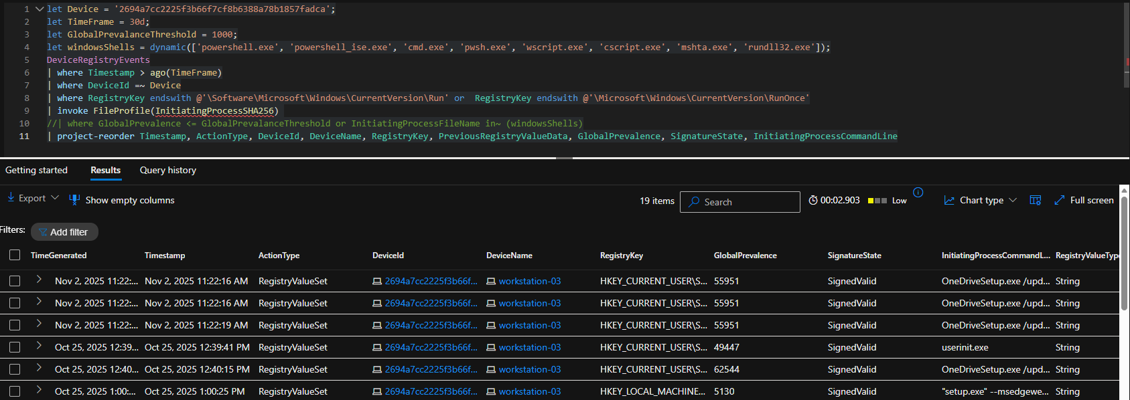
FileProfile()
ht

Slide 28
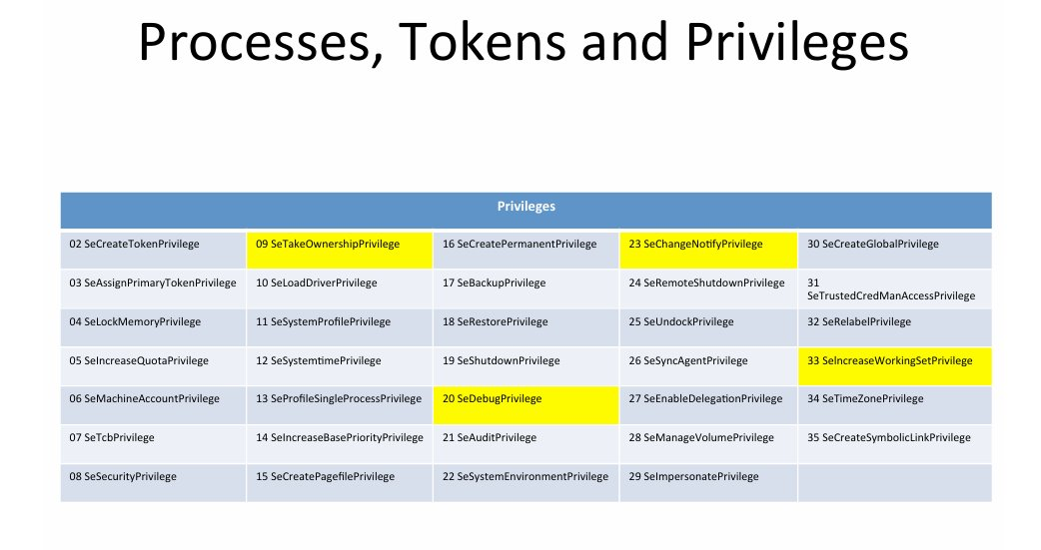
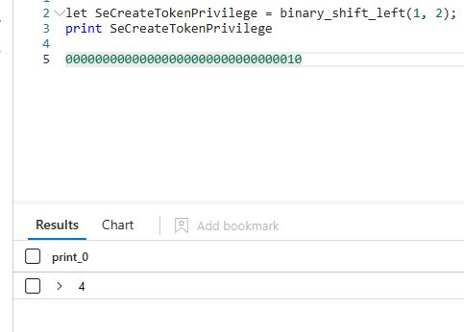
binary_shift_left()
Token analysis
Moves the bits to the left, filling the positions on the right with zeros
https://downloads.volatilityfoundation.org//omfw/2012/OMFW2012_Gurkok.pdf

Slide 29
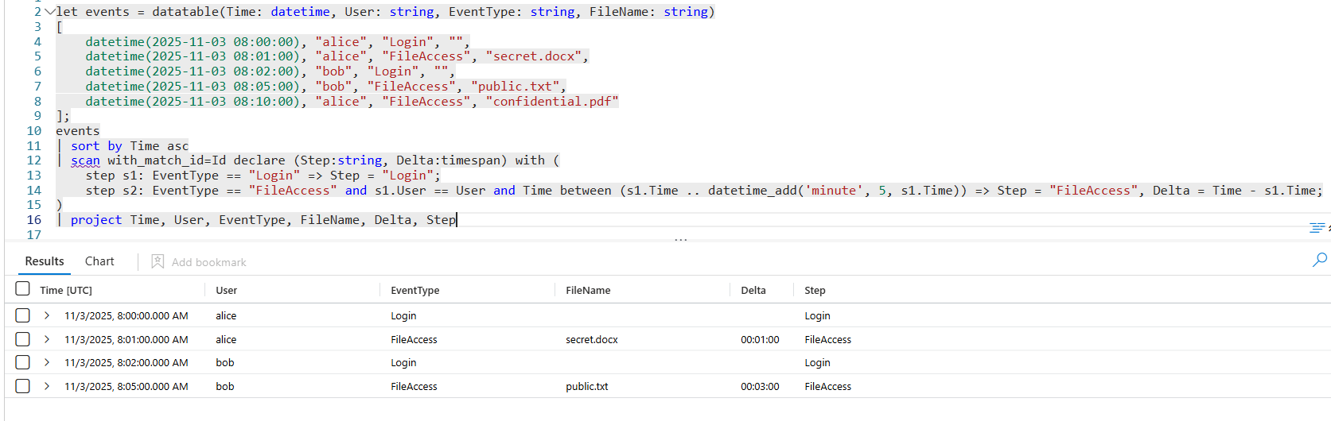
scan
Scans data, matches, and builds sequences based on the predicates.
Notes:
let events = datatable(Time: datetime, User: string, EventType: string, FileName: string)
[
datetime(2025-11-03 08:00:00), "alice", "Login", "",
datetime(2025-11-03 08:01:00), "alice", "FileAccess", "secret.docx",
datetime(2025-11-03 08:02:00), "bob", "Login", "",
datetime(2025-11-03 08:05:00), "bob", "FileAccess", "public.txt",
datetime(2025-11-03 08:10:00), "alice", "FileAccess", "confidential.pdf"
];
events
| sort by Time asc
| scan with_match_id=Id declare (Step:string, Delta:timespan) with (
step s1: EventType == "Login" => Step = "Login";
step s2: EventType == "FileAccess" and s1.User == User and Time between (s1.Time .. datetime_add('minute', 5, s1.Time)) => Step = "FileAccess", Delta = Time - s1.Time;
)
| project Time, User, EventType, FileName, Delta, Step

Slide 30
Attack Challenges

Slide 31
Hands on labs: Attacks Challenges
Lab link: https://github.com/Bert-JanP/KustoCon2025

Slide 32
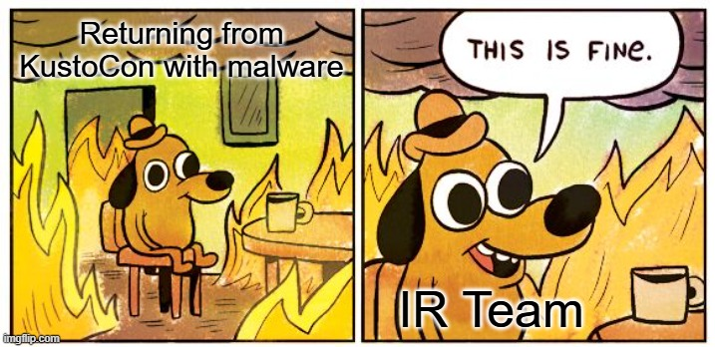
⚠️Real malware is used!
We have some IR experts onsite in case you get compromised.
Serious note:
Level 1 and 2 contain malware samples
Downloading files at your own risk, not required for the lab

Slide 33
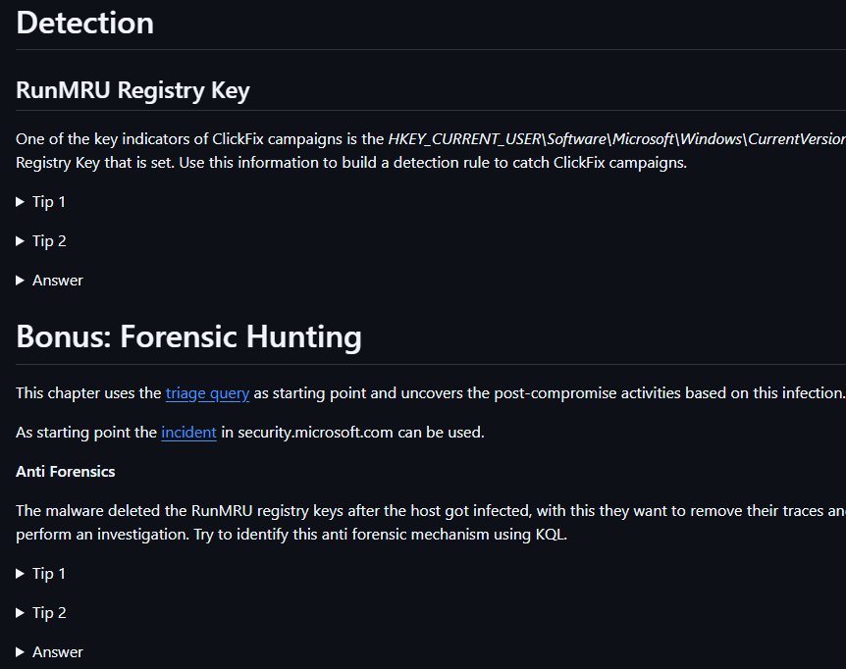
Tips included in the markdown files
Be aware of the triggered alerts (30 days back)
Feel free to ask us anything :)

Slide 34
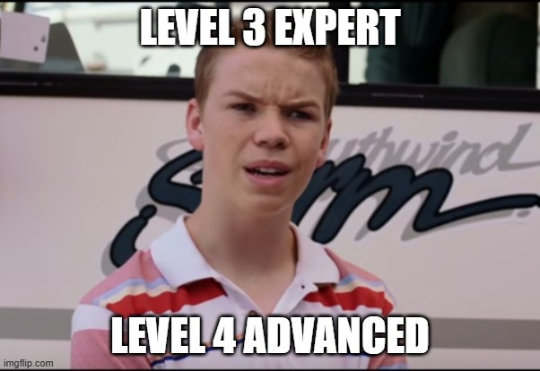
Time is limited
Based on your expertise select the levels you want to do. We will discuss all levels at the end.
Level | Difficulty
1 | Beginner
2 | Medium
3 | Expert
4 | Advanced

Slide 35
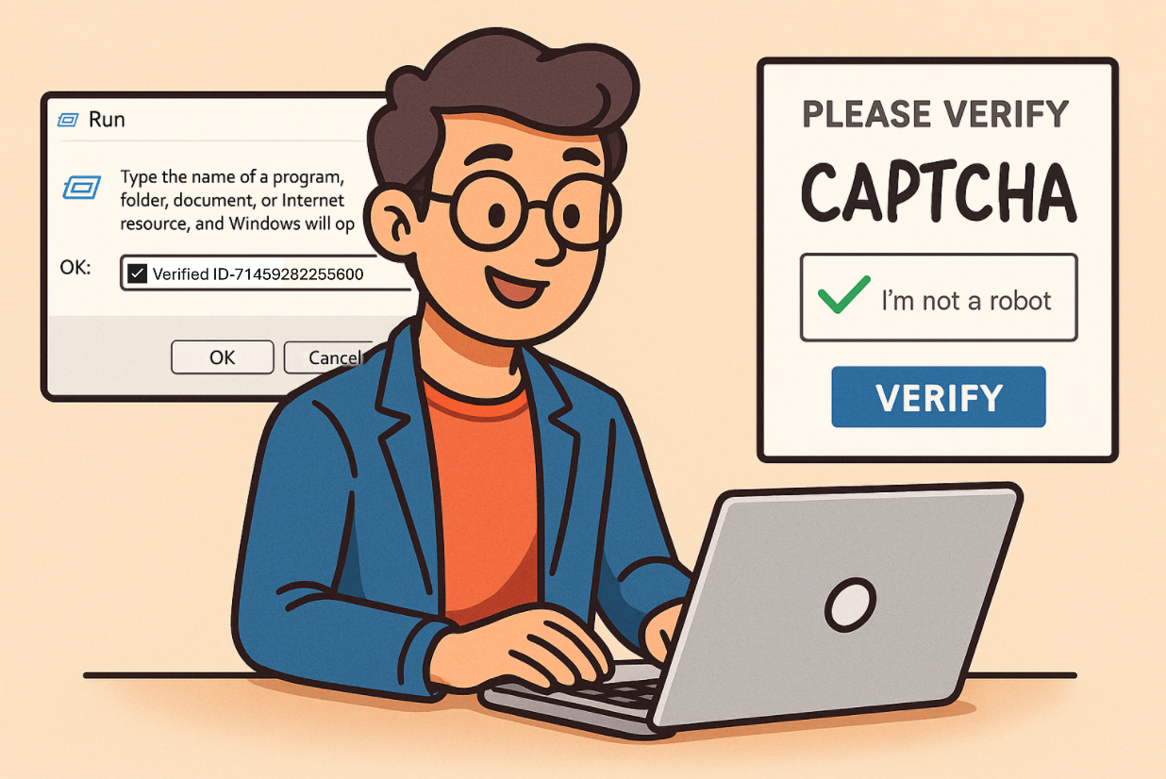
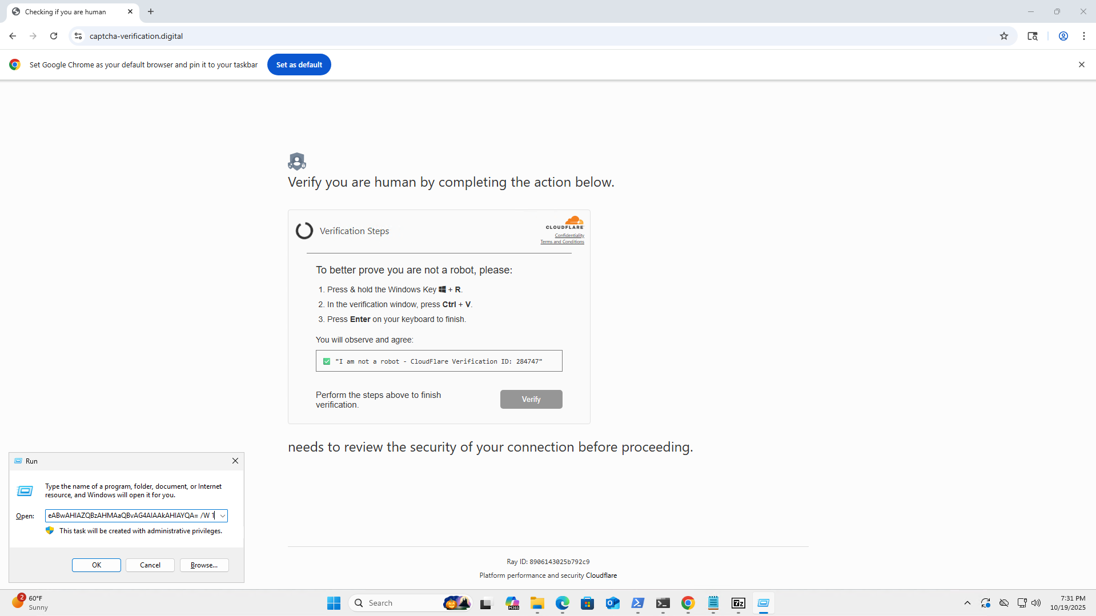
Level 1: ClickFix

Slide 36
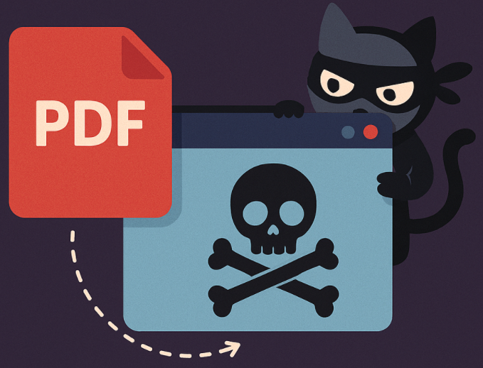
Level 2: Manual Finder
Tips included
in the
markdown files
Feel free to ask
us anything :)

Slide 37
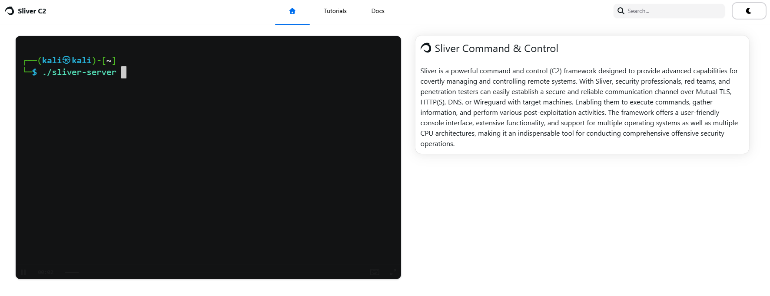
Sliver C2
ht
Docs: https://sliver.sh

Slide 38
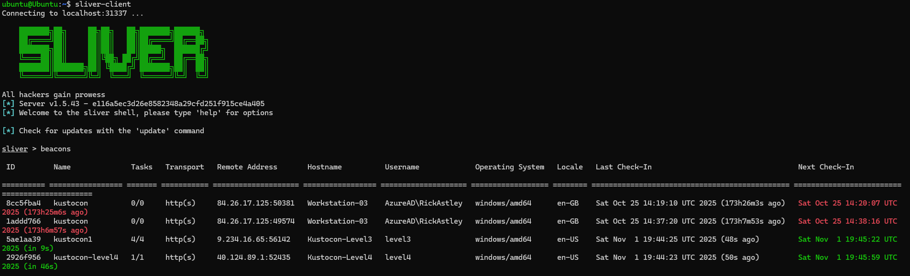

Slide 39
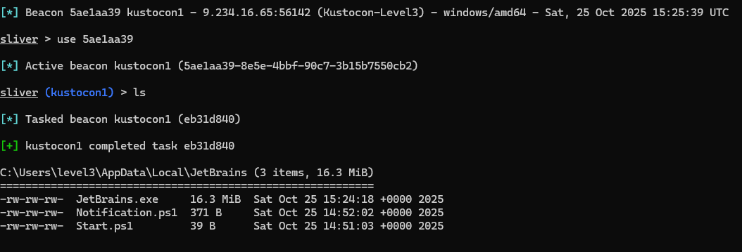
Level 3: Initial Access Broker
Access to your company is being sold.
You have received the screenshot below from your national CERT

Slide 40
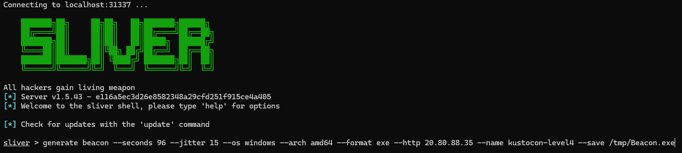
Level 4: Beaconing

Slide 41
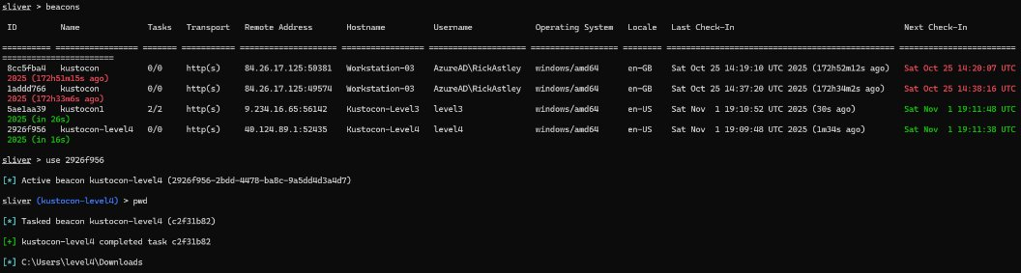

Slide 42
Break ☕

Slide 43
ACompanyLikeYours
What can possibly go wrong?

Slide 44
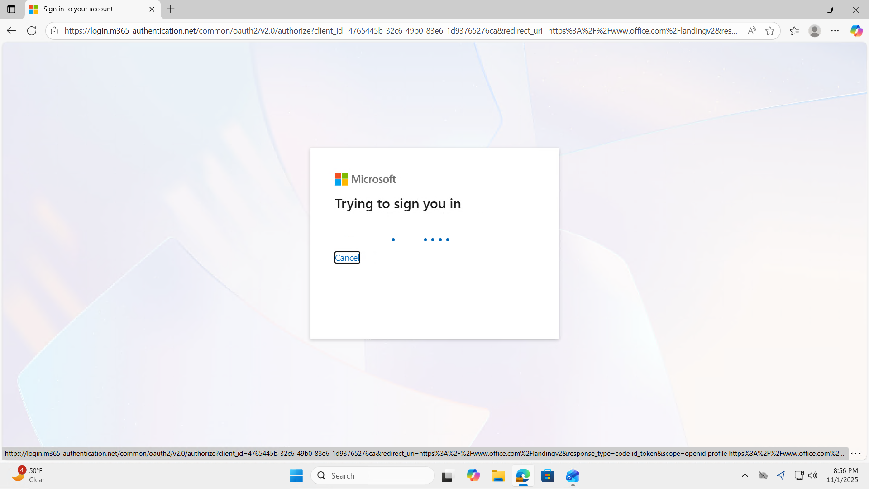

Slide 45
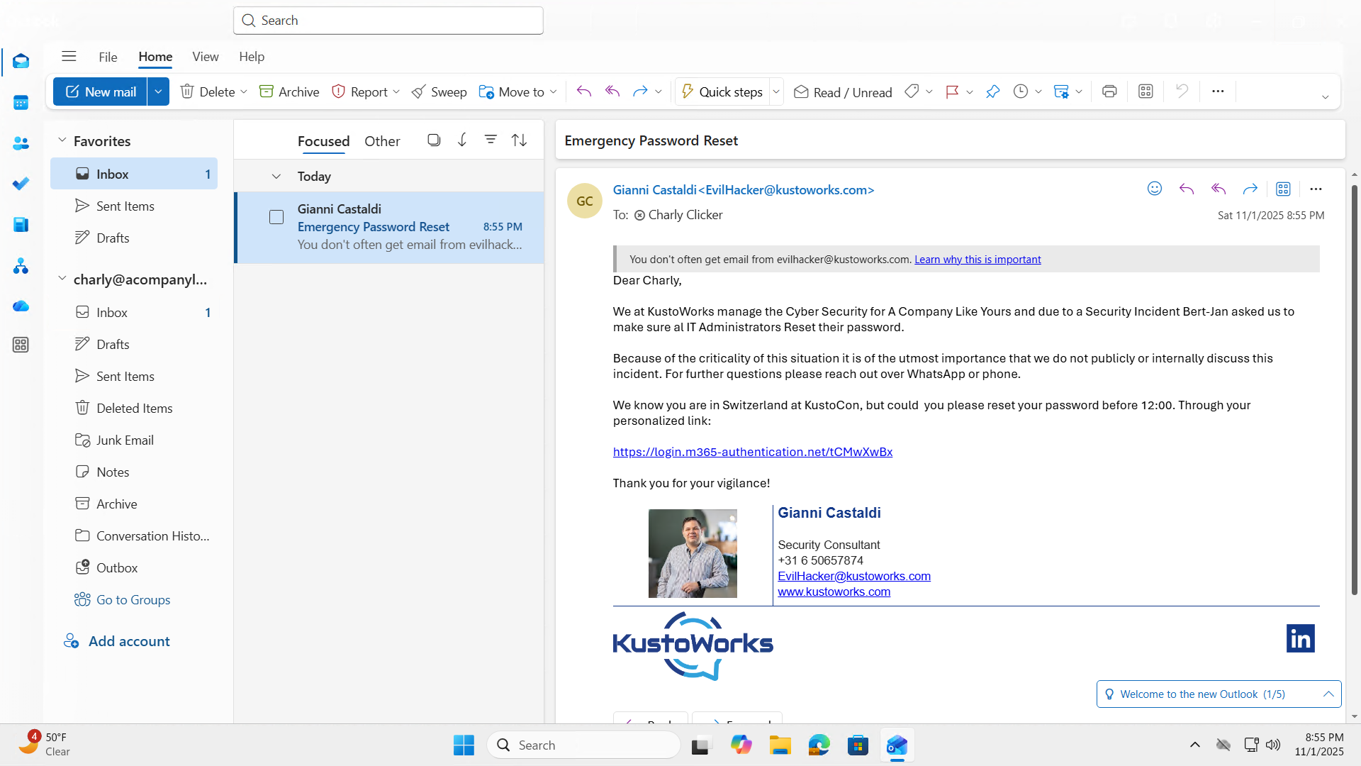

Slide 46
Lets get started

Slide 47
Session Title

